Slide 1
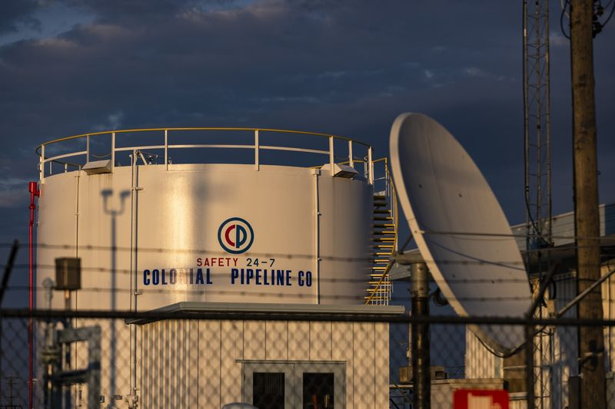
IBM Attack Case Study
Colonial Pipeline Breach
Presented by: Tevin Davis

Slide 2
Attack Category
(Ransomware)
What is Ransomware?
Ransomware is malware designed to deny a user or organization access to files on their computer. By encrypting these files and demanding a ransom payment for the decryption key, cyber attackers place organizations in a position where paying the ransom is the easiest and cheapest way to regain access to their files. Some variants have added additional functionality such as data theft, to provide further incentive for ransomware victims to pay the ransom.
Ransomware has quickly become the most prominent and visible type of malware. Recent ransomware attacks have impacted hospitals’ ability to provide crucial services, crippled public services in cities, and caused significant damage to various organizations.
According to detections by Trellix, after banking and finance, the utility sector accounted for 20% of detected attacks and was one of the most common targets for ransomware during the reporting period.

Slide 3
Company description:
The Colonial Pipeline comprises more than 5,500 miles of pipeline. It starts in Texas and moves all the way up through New Jersey, supplying 45% of the fuel for the East Coast. The Colonial Pipeline delivers refined oil for gasoline, jet fuel, and home heating oil.
Summary of the security incident and data breach:
The Russian hacker group “Darkside” entered the networks of Colonial Pipeline Co. on April 29 through a virtual private network account, which allowed employees to remotely access the company’s computer network. This was the result of a single compromised password, according to a cybersecurity consultant who responded to the attack. This allowed Dark-Side to access Colonial Pipeline billing infrastructure, on May 7, an employee in Colonial’s control room saw a ransom note demanding cryptocurrency appear on a computer just before 5 a.m. The Pipeline was shut down as a result on the same day at 6:10 a.m.

Slide 4
Timeline
1
Hacker group Dark-Side entered the networks of Colonial Pipeline Co. on April 29 through a virtual private network account (VPN), which allowed employees to remotely access the company’s computer network. This allowed Dark-Side to access Colonial Pipeline billing infrastructure.
A little more than one week later, on May 7, an employee in Colonial’s control room saw a ransom note demanding cryptocurrency appear on a computer just before 5 a.m.
The employee notified an operations supervisor who immediately began to start the process of shutting down the pipeline. By 6:10 a.m., the entire pipeline had been shut down.
It was only after Mandiant, and Colonial were able to conclusively determine that the attack had been contained that they considered re-opening their pipeline.
On May 9, Colonial stated they planned to substantially repair and restore the pipeline's operations by the end of the week. U.S. President Joe Biden declared a state of emergency on 9th May 2021 Dark Side released a statement on May 9 that did not directly mention the attack, but claimed that "our goal is to make money, and not creating problems for society"
On May 10, Georgia Governor Brian Kemp declared a state of emergency and temporarily waived collection of the state's taxes on motor fuels (diesel and gasoline). Colonial began resuming service at 5 p.m. on May 12
2
3
4
Colonial Pipeline Attack
5
6

Slide 5
Vulnerabilities
Vulnerability #1
Use of single-factor login system
Vulnerability #2
Using a legacy Virtual Private Network (VPN), that was not maintained and/or managed.
Overall Summary:
The attacker exploited compromised passwords and usernames obtained on the dark web to enter Colonial Pipeline Network.
Vulnerability #3
Weaknesses in the Transportation Security Administration’s (TSA's) management of its pipeline security efforts.
Vulnerability #4
Operation during the attack: Business operations were shut down during the attack.

Slide 6
Costs
Prevention
Colonial Pipeline paid a $4.4 million (USD), 75 Bitcoin ransom to Dark-Side for the decryption keys to unlock their systems.
63.7 bitcoins out of 75 paid out were recovered by the FBI
Joseph Blount, President and CEO of Colonial Pipeline acknowledged that it would take months and cost the company “tens of millions of dollars” to fully repair the damage and restore all its business systems.
The outage led to long lines at gas stations, many of which ran out, and higher fuel prices.
It took weeks for Colonial Pipeline to restore its billing systems just to allow them to get paid for oil distribution.
In addition, the reputational cost to Colonial is incalculable – overnight they went from one of the biggest companies the average person had never heard of, to being the subject of constant, negative headlines
A SIEM solution, coupled with advanced threat intelligence, detection, and monitoring could’ve helped to recognize anomalous activities that would’ve signaled the early stages of an attack before the real trouble started.
Multi-factor authentication (MFA) should have been required to access the IT infrastructure of the largest refined oil pipeline system in the United States.
Maintaining segregation of OT and IT networks, other than where essential and tightly controlled and monitored, can help contain risk. As integrations are contemplated, it is essential to build in security and audit into infrastructure from day one.

